Slide 1
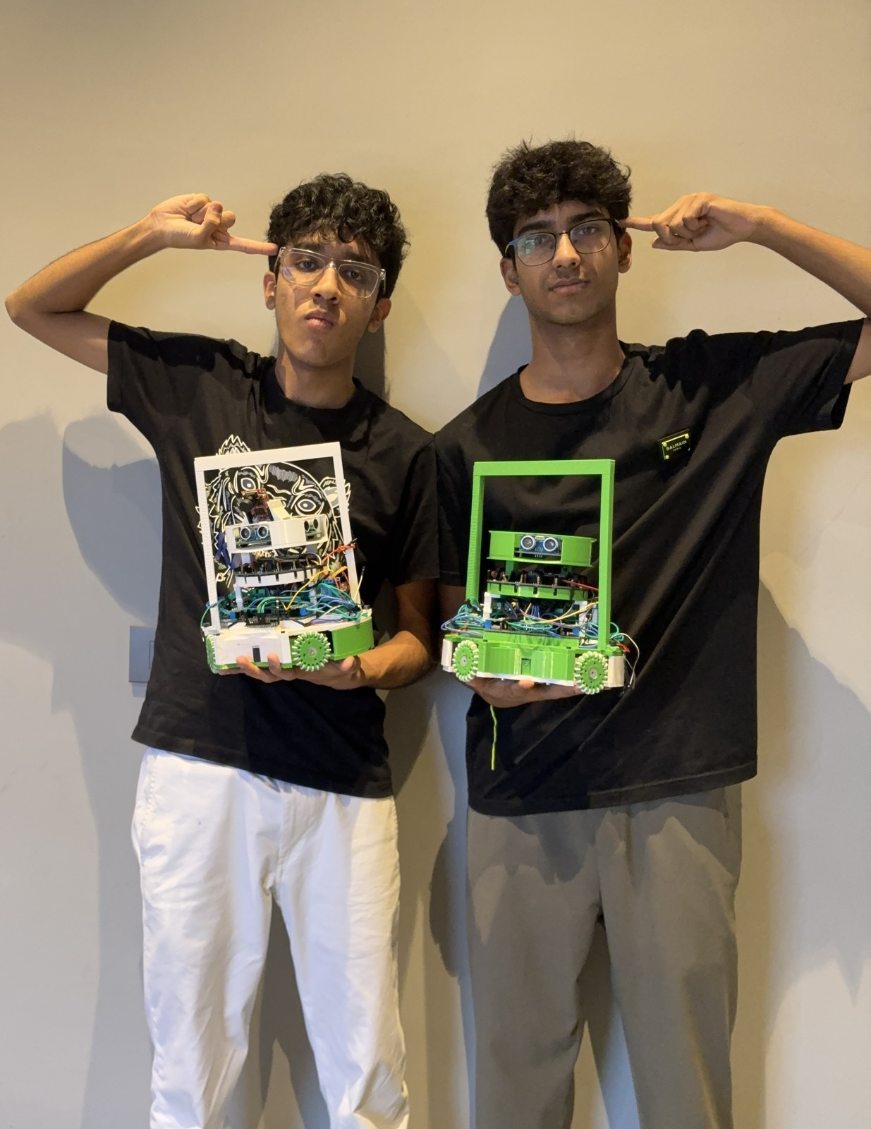
VVS Ballers
RoboCupJunior Soccer · IR League (Lightweight)
International Finals 2025-26 · India
Kushal Sachdeva — Team Lead · Electrical, Software & CAD
Darsh Goel — Mechanical & CAD
2
5
16
ROBOTS
CUSTOM PCBs
IR SENSORS
Kushal Sachdeva & Darsh Goel with both robots
Notes:
BOTH present (Kushal opens). ~25s: Hi, we're VVS Ballers from India in the IR League. I'm Kushal - team lead, electronics/firmware/CAD. I'm Darsh - mechanical and CAD. We field TWO robots on one shared platform: one attacker, one defender, trading roles automatically if a robot goes down. Almost everything - wheels, five PCBs, all firmware - we built from scratch this season. [TODO: confirm 'Lightweight World Champions' - not in sources; verifiable: 2025-26 India Nationals 1st + 2024-25 Brazil Top 20.]

Slide 2
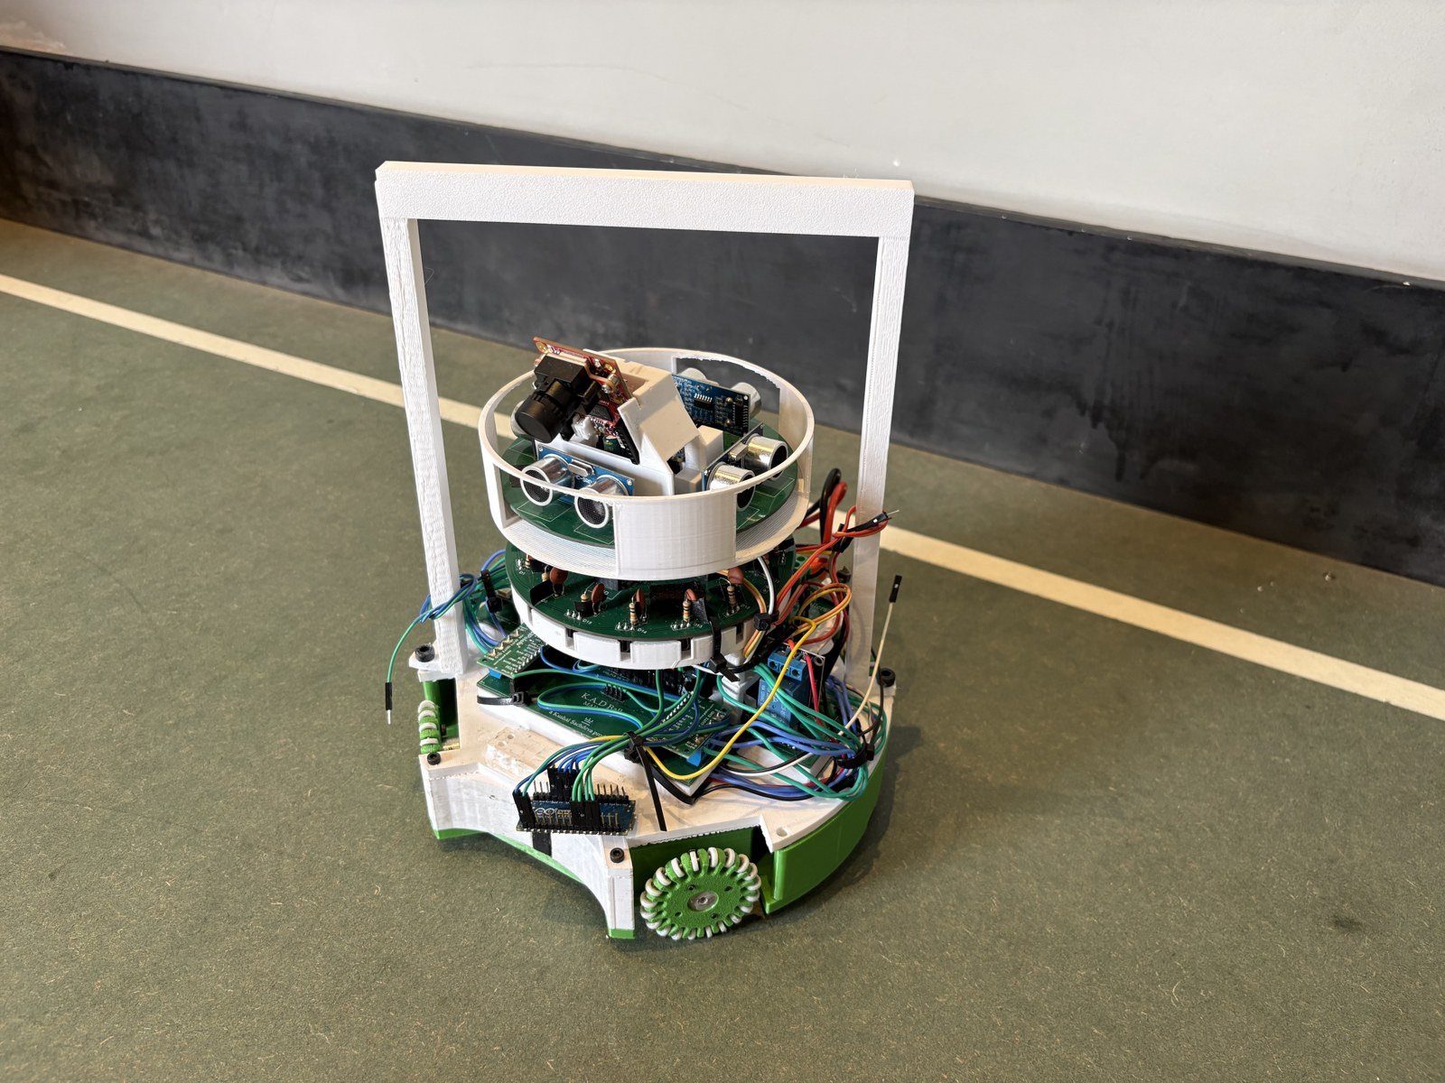
2
ROBOT AT A GLANCE
Robot at a Glance
Two identical robots; only the firmware role differs — one attacks, one defends.
Two robots, one shared platform — role set in firmware
Inside IR-league limits: <= 22 cm wide, <= 1.5 kg
Holonomic drive — 4 self-printed omni wheels (diamond)
Brains: 3x Teensy 4.1 + 2x Nano Every + OpenMV H7
Senses: 16-IR ring, camera, line array, 4 ultrasonics, IMU
Scores with a 48 V solenoid kicker
Competition robot — within 22 cm / 1.5 kg
22 cm
16
48 V
MAX WIDTH
IR SENSORS
KICKER
Notes:
~35s (Kushal): Quick tour. Both robots are identical hardware - only the firmware role differs. Each fits the IR box: under 22 cm and 1.5 kg. They drive holonomically on four omni wheels we printed ourselves, so they strafe straight at the ball from any angle while facing forward. Three Teensy 4.1s, two Nanos and an OpenMV camera split the work. Sensing: a 16-sensor IR ring, camera, floor line-array, four ultrasonics and a gyro. The attacker scores with a 48 V solenoid. Darsh will start with the part we're proudest of.

Slide 3
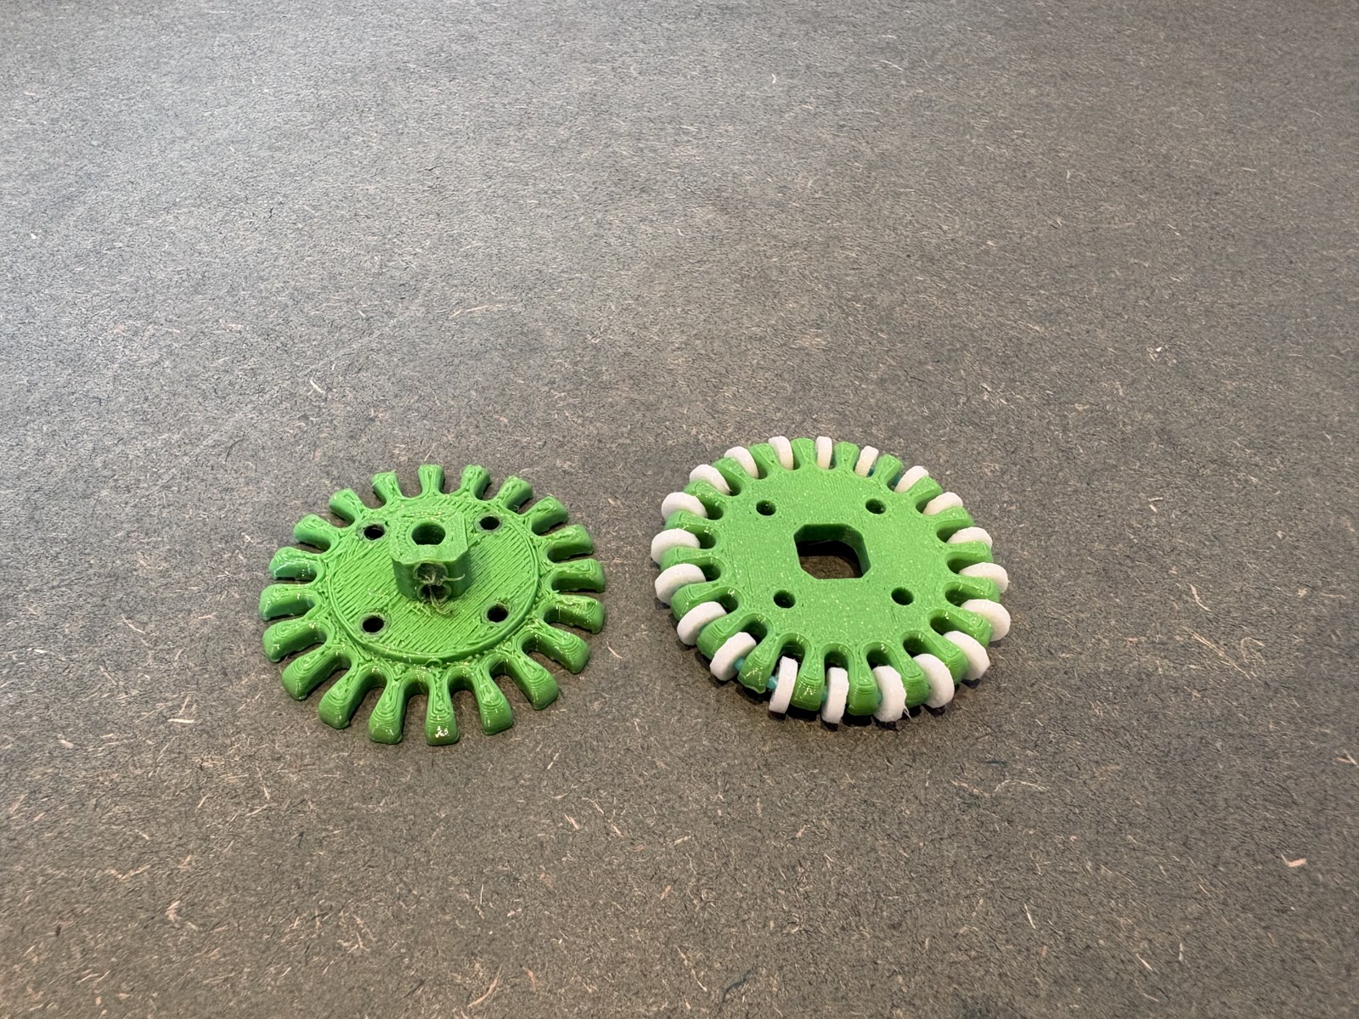
3
SIGNATURE INNOVATION
Omni Wheels We Print at Home
No off-the-shelf wheel fit our size limit — so we print the whole wheel, axles included.
Fully 3D-printed omni wheel — including the roller axles
PETG hub (stiff) + TPU rollers at 15% infill (grip)
Roller axle printed from PETG filament — nothing bought
3 print rounds: diameter, roller count, grip, concentricity
Replicable on any home printer — files published
Fully-printed wheel — PETG hub, TPU rollers, printed PETG axle
3
15%
0
PRINT ROUNDS
TPU INFILL
MACHINED PARTS
Notes:
~40s (Darsh): This is the part we're proudest of - and you can hold it. Most teams buy omni wheels or print only the hub and buy the rollers and metal axles. Ours is ENTIRELY printed: PETG hub, TPU rollers at 15% infill for grip, and even the axle the rollers spin on is printed from PETG filament. Nothing bought, nothing machined. No commercial wheel fit both our 22 cm limit and the smaller 2026 ball. Three print rounds to get roller diameter, count, grip and concentricity right. Any team with a home printer can make the same wheel - files are public. Kushal (~10s): Two runner-ups - a federated five-PCB stack with error-checked serial, and camera + IR fusion for short range.

Slide 4
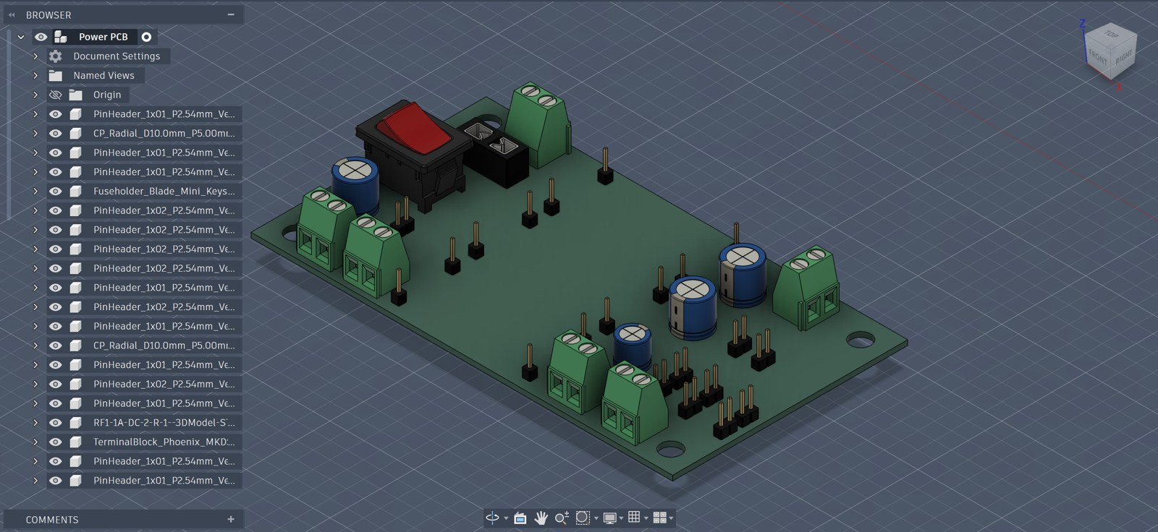
4
ELECTRICAL
A Federated 5-PCB Stack
Five purpose-built boards, one battery, and error-checked links between them.
5 custom JLCPCB boards: Power, Main, IR, Line, Ultrasonic
One 12 V LiPo -> 4 clean rails: 12 V, 5 V, 3.3 V, 48 V
Each board has its own MCU; CRC-8 framed UART
A bad byte on any wire is rejected, not acted on
4x DRV8263H drivers (PH/EN), one per wheel
Power PCB (3D) — one battery, four rails: 12/5/3.3/48 V
5
4
CRC-8
CUSTOM PCBs
POWER RAILS
CHECKED LINKS
Notes:
~40s (Kushal): Five boards we designed in KiCad and made at JLCPCB. Federated - each board has its own microcontroller and one job - which keeps wiring clean and lets every sensor run full speed. The Power PCB is a favourite: from one 12 V LiPo it makes four rails on a single board - 5 V for the Teensys and camera, 3.3 for sensor logic, 48 V boost for the kicker - with bulk caps on each rail. Boards talk to the main Teensy over UART, every message wrapped in a CRC-8 checksum, so a mid-match wire glitch is thrown away instead of steering us into a wall. Each wheel has its own DRV8263H driver in PH/EN mode.

Slide 5
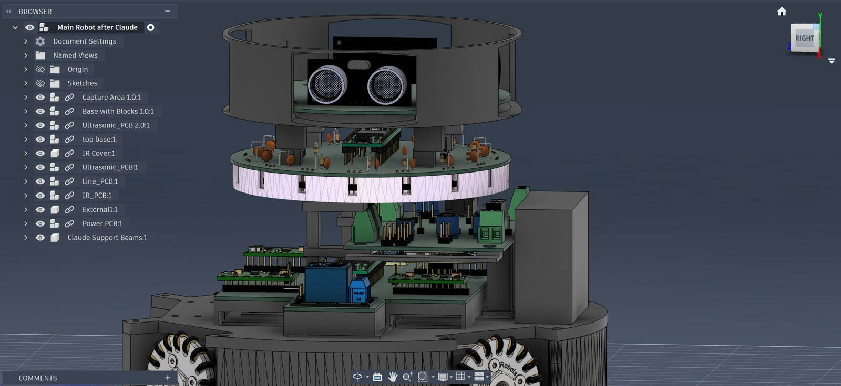
5
MECHANICAL
Frame, Wheels & Kicker
A rigid printed frame keeps the sensor ring true — if the IR ring tilts, the bearing lies.
Fusion 360 from hand sketches; 3- vs 4-wheel studied with our physics teacher
4-wheel diamond — holonomic agility + even pushing force
Support-beam frame keeps the 16-IR ring rigid & planar
Capture mouth cradles the ball in the 1.5 cm zone
PETG structure / TPU grip · Bambu Lab · debug door flap
Printed support-beam frame keeps the 16-IR ring rigid & planar
4
1.5 cm
PETG+TPU
OMNI WHEELS
BALL ZONE
MATERIALS
Notes:
~35s (Darsh): We designed everything in Fusion 360 from hand sketches, and with our physics teacher compared 3- vs 4-wheel layouts, wheel diameters and sensor placement - all inside 22 cm and 1.5 kg. The 4-wheel diamond won: holonomic, and it spreads pushing force evenly in duels. The piece I'm proud of is a printed support-beam frame that clamps the main board, IR cover and ultrasonic board into one rigid stack, so the 16-sensor IR ring stays flat and aligned after collisions. The capture mouth cradles the ball in the legal 1.5 cm zone, and a printed door flap lets us watch the electronics and recalibrate mid-match.

Slide 6
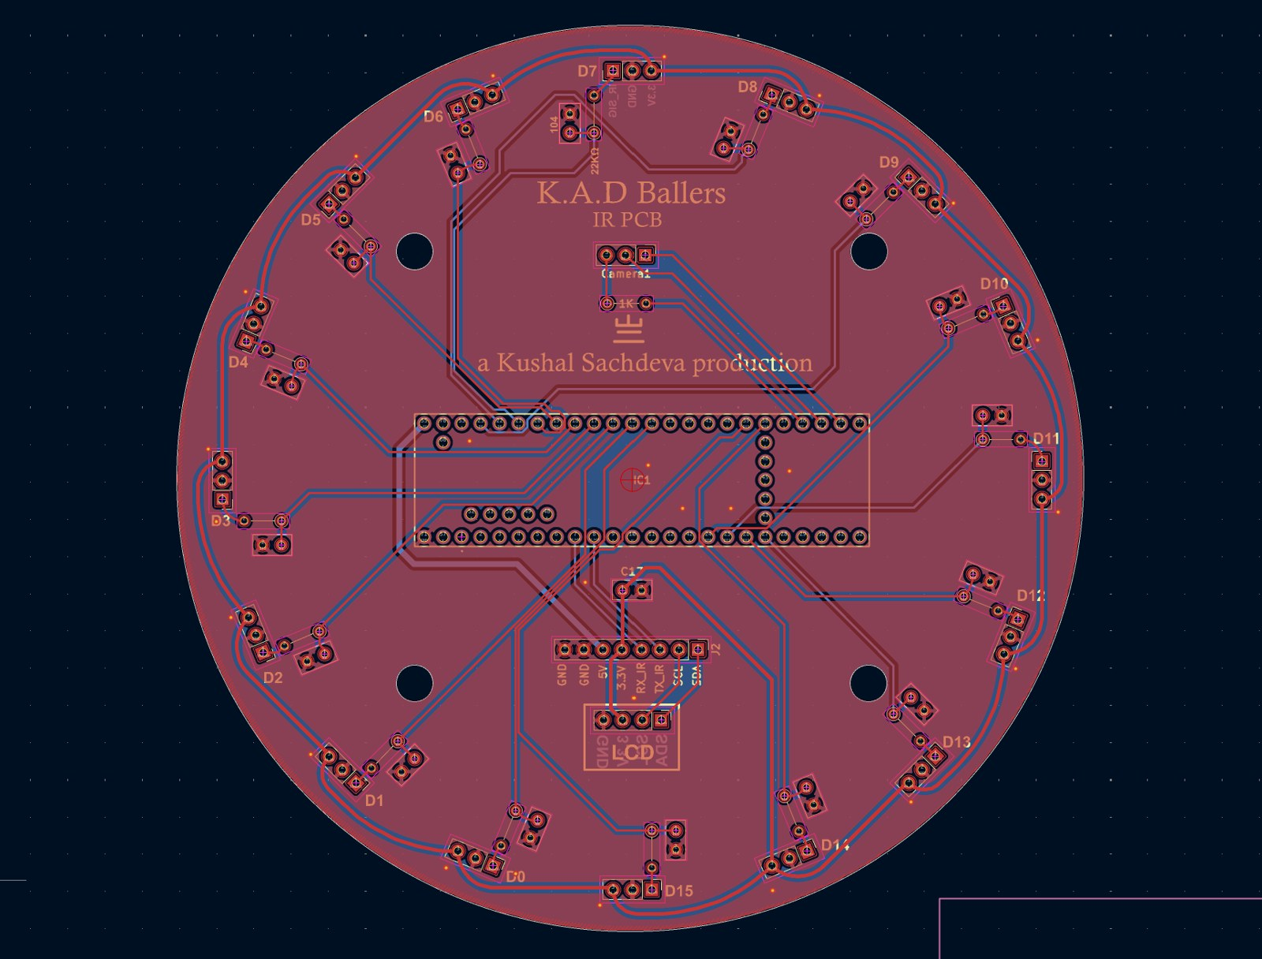
6
SENSING & SOFTWARE
Clean Data from Cheap Sensors
The edge isn't expensive sensors — it's the filtering that turns them into clean data.
16x TSSP58038 ring -> intensity-weighted vector sum (atan2)
Hysteresis 60/35 + EWMA smoothing -> steady bearing
Camera + IR fusion reconfirms the bearing < 60 cm
Line: 4x QTR-MD-05A (18 sensors), 'line' when >= 2 cross
BNO055 (IMUPLUS) -> 100 Hz heading-hold PID
IR ring PCB — 16x TSSP58038, each with its own RC filter
16
100 Hz
18
IR RECEIVERS
HEADING PID
LINE SENSORS
Notes:
~40s (Kushal): The win is filtering, not expensive parts. Each of 16 IR receivers gives an intensity - baseline minus reading - and instead of picking the strongest, we take an intensity-weighted vector sum across every lit sensor with an atan2, add hysteresis and a moving average, and get a smooth bearing on a small, fast ball. Past ~60 cm the ring gets unsure, so the OpenMV camera also finds the orange ball and reconfirms direction. The line-array flags a boundary only when >=2 sensors see white, the four ultrasonics are median-filtered, and a BNO055 gyro in IMUPLUS mode feeds a 100 Hz heading-hold PID that keeps us straight while we strafe.

Slide 7
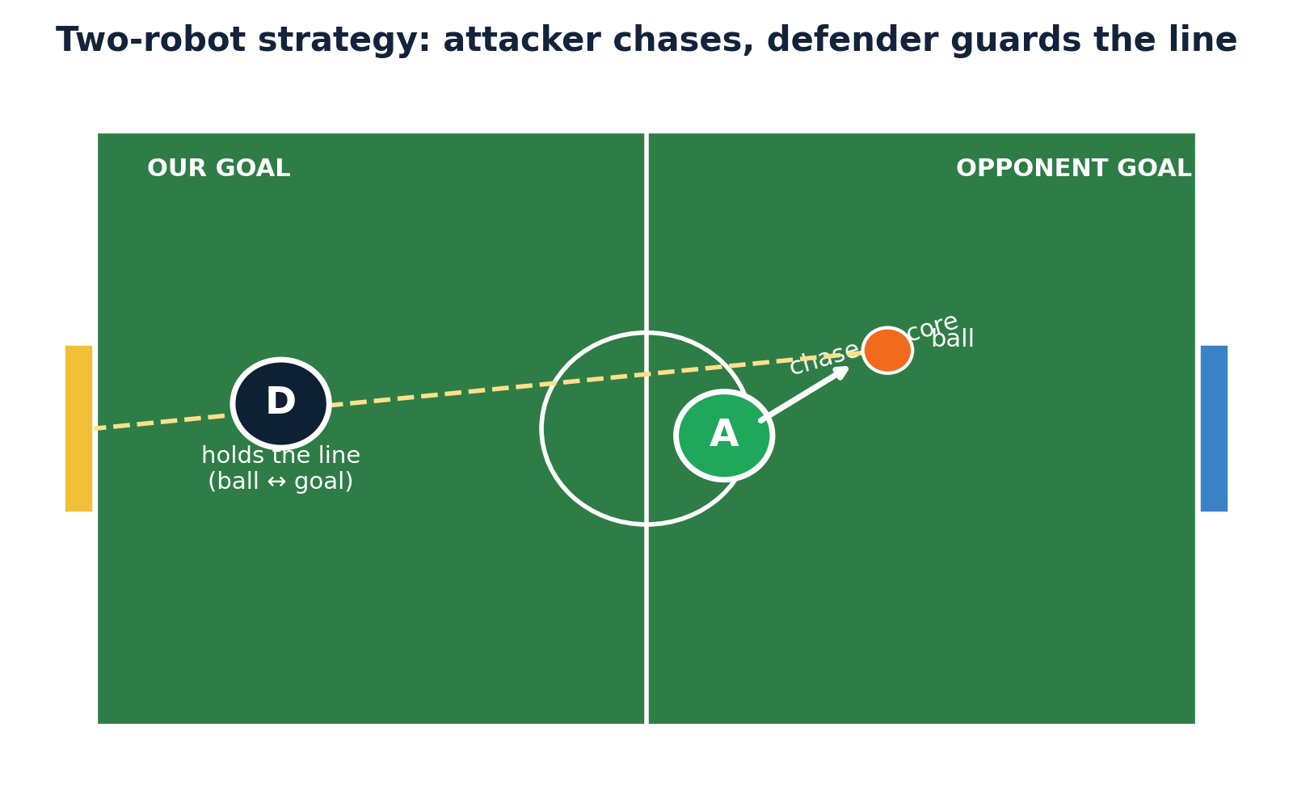
7
STRATEGY
The Goal Is Never Left Open
One robot chases and scores; the other never leaves the goal — and they cover for each other.
Attacker: drive straight at ball (speed 250), gyro holds heading
On capture (< 45 mm): spin to open corner within 5°, fire
Defender: lateral PID stays between ball & goal
GUARD -> TRACK -> CLEAR -> RECOVER; back-wall < 90 mm safety
Auto role-switch over 2.4 GHz if a robot is removed
Attacker chases & scores; defender holds the ball–goal line
250
5°
2.4 GHz
DRIVE SPEED
AIM WINDOW
ROLE-SWITCH
Notes:
~40s. Darsh: One robot chases and scores, one never leaves the goal. The attacker sorts the IR bearing into a drive direction and goes straight at the ball at full translate speed while the gyro holds it facing forward. On capture it holds heading, spins until the camera's open corner is within five degrees, and only then kicks - past the keeper. The defender stays on its goal line and runs a sideways PID on the ball's bearing to keep its body between ball and net, with an intercept boost when the ball moves fast. Kushal: They talk over 2.4 GHz - the only band RCJ allows. If the attacker is fouled or pulled off, the defender switches to attacker, so we're never a robot down AND wide open. They swap back at kick-off.

Slide 8
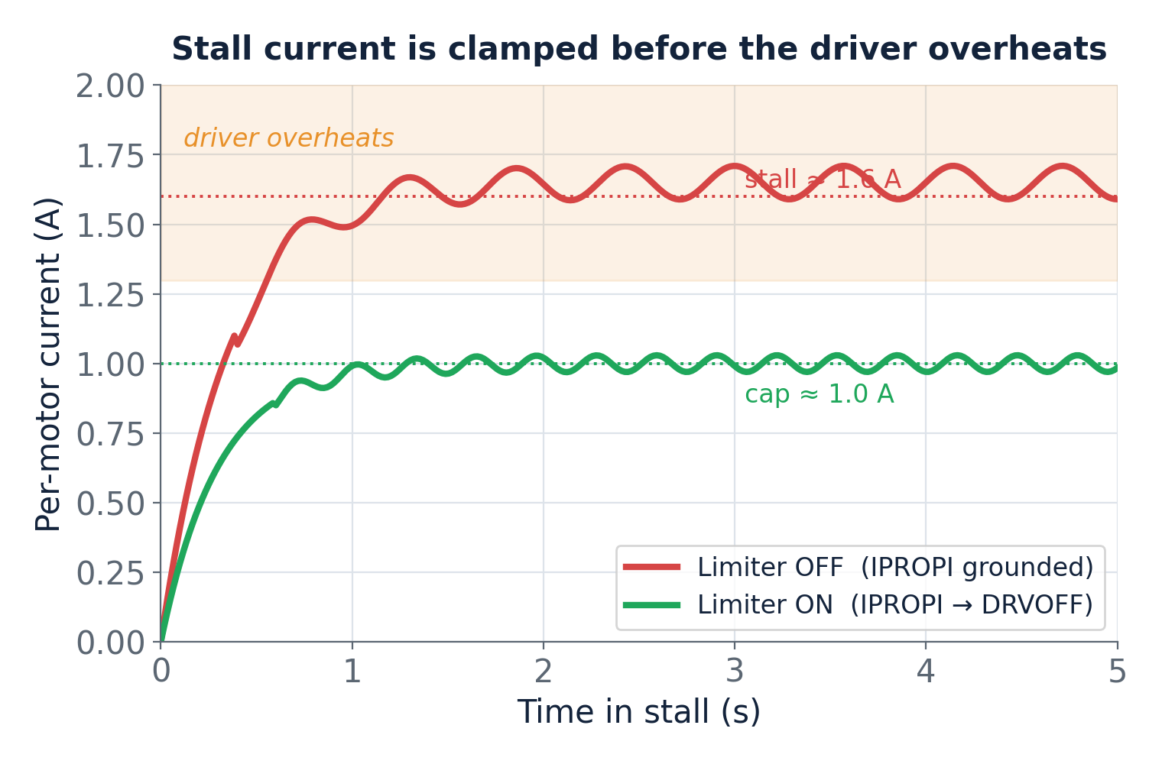
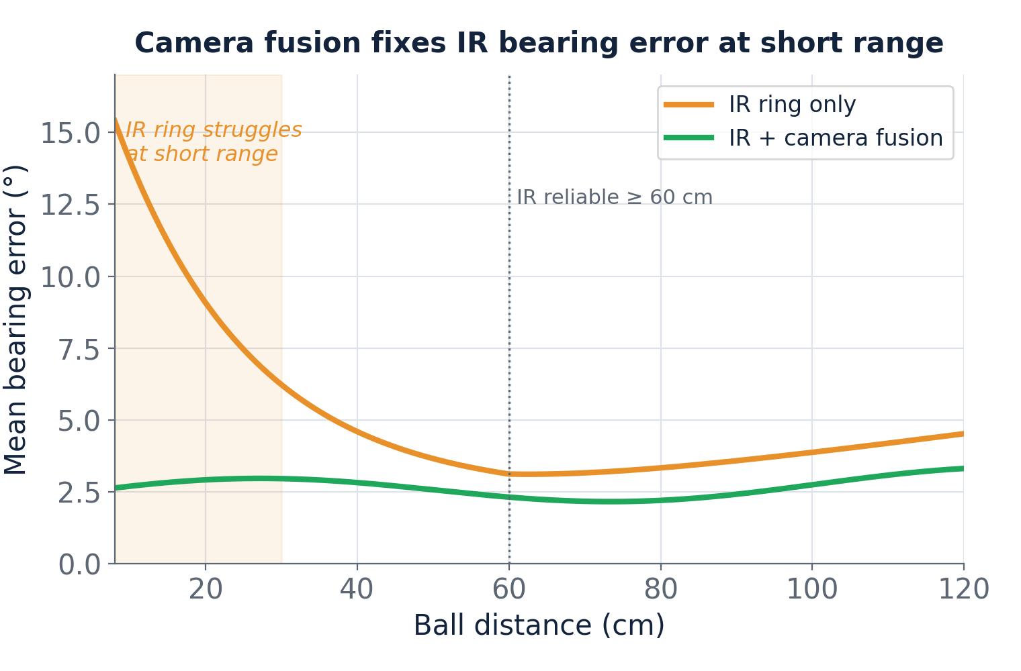
8
DATA · TESTING → MODIFICATION
Every Fix Came From a Failure
Each change below was forced by a measured failure on the field.
Overheating → external Nano caps current at ~1 A (stall 1.6 A)
IR lost the ball < 60 cm → camera fusion holds bearing error low
~1 A
< 60 cm
3
CURRENT CAP (was ~5 A)
FUSION FIXES IR
FIELD FIXES SHIPPED
Notes:
~40s (Kushal): Every number here came from a failure. LEFT: we first grounded the drivers' current pins for max current; after ~5 min of pushing they overheated. A separate Arduino Nano now reads each driver's current sense and pulls DRVOFF to coast the motor above ~1 A - stall would be 1.6. Current clamps flat instead of climbing into the danger zone; the robot stays fast, lasts the whole match, and it's isolated so it protects the motors even if the main code hangs. RIGHT: IR-only bearing error spikes close to the ball; camera fusion keeps it low. Two more: bulk caps fixed an ultrasonic board that reset under load, and the wheels took three print rounds to get grip and concentricity right.

Slide 9
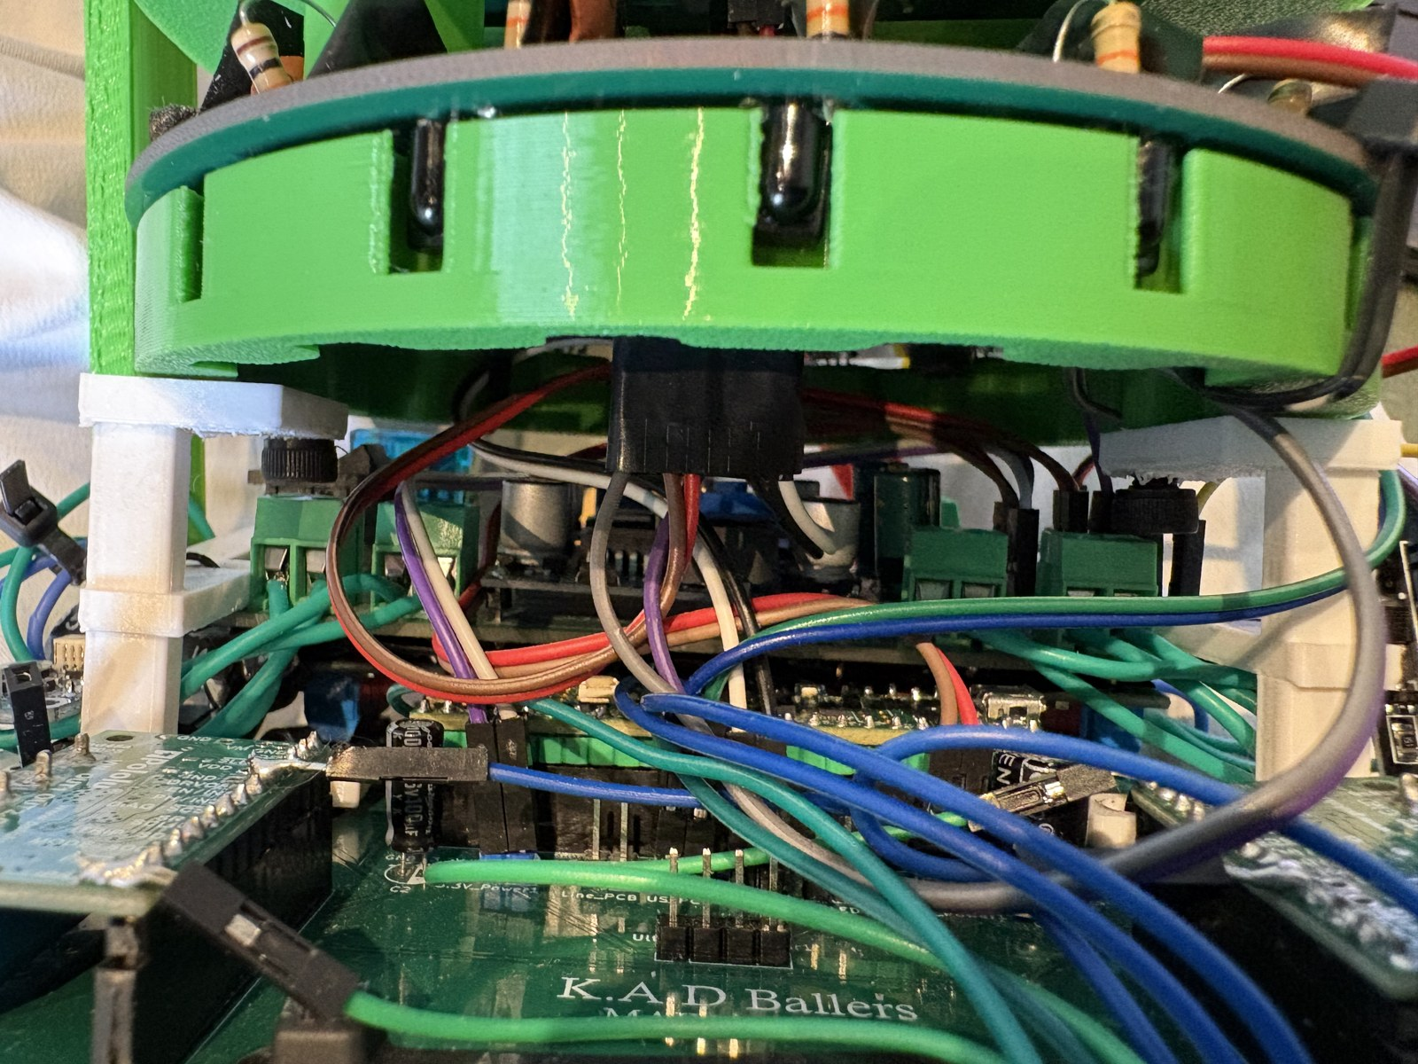
9
TEAMWORK & PROCESS
How We Work: Roles, Tools & Iteration
A two-person team with clear ownership, tracked tasks, and a five-month build.
Kushal: electronics, firmware, PCB & CAD · Darsh: mechanical & CAD
Planned in Notion — every task owned, with a deadline
Files on Google Drive · code + issues on GitHub · WhatsApp
Feb-May: 4 hrs/day · 7-27 June: 8-10 hrs/day sprint
AI-assisted CAD: Fusion 360 MCP for IR beams + 2 PCBs
Hands-on: the 5 V / 3.3 V / UART wiring loom
2
~5 mo
8-10 h
TEAM MEMBERS
BUILD TIME
JUNE / DAY
Notes:
~30s. Darsh: Two-person team, clear roles: I own mechanical design and share CAD; Kushal owns electronics, firmware and PCBs and shares CAD. We planned in Notion - every task has an owner and a deadline - kept design files on Google Drive, and used GitHub for code and issues. Kushal: We built from February, four hours a day, then an 8-10 hour daily sprint through June. We used AI well - Claude's Fusion 360 tool helped lay out the IR support beams and two PCBs - and we can explain what it did versus what we decided.

Slide 10
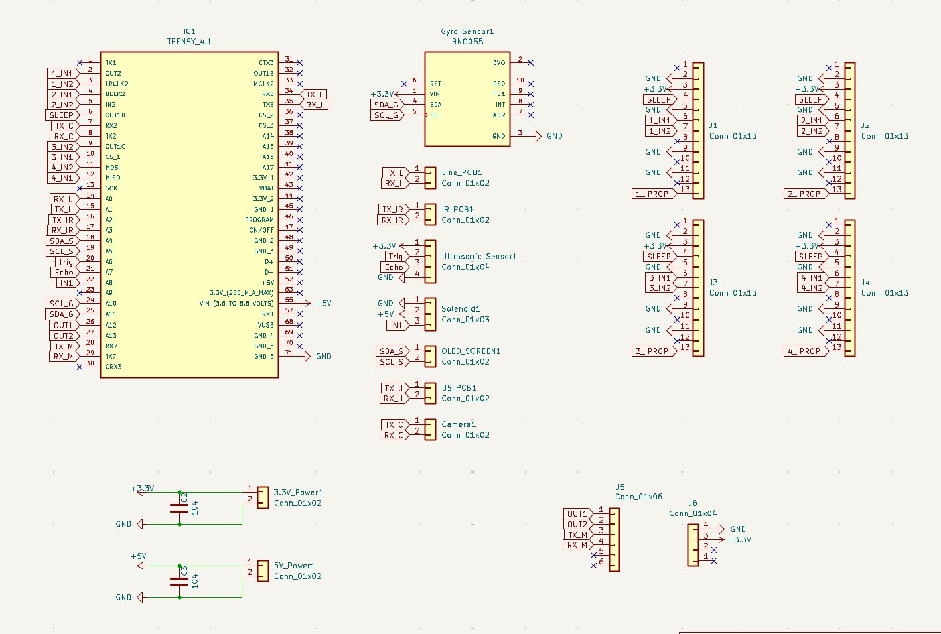
10
OPEN SOURCE · GIVING BACK
Everything Is Open Source
Everything needed to rebuild our robot is public — take it and go further.
Public GitHub: firmware, KiCad PCBs/schematics, CAD, posters
Printed omni wheel + 5-PCB architecture fully replicable
BOM with part numbers & prices (~ EUR 600/robot)
Contact: vvsballers@gmail.com · @vvs_ballers
Ask us anything — we're happy to help you build one
All KiCad schematics & PCBs published for other teams
100%
€600
47
OPEN SOURCE
PER ROBOT
GIT COMMITS
Notes:
~30s (Kushal): RoboCup is about sharing, so we published everything: firmware, KiCad schematics and PCBs, the Fusion CAD for wheels and frame, our posters, and a full BOM with part numbers and prices - about 600 euros a robot. The two things we'd most want another team to steal are the fully-printed omni wheel and the five-board layout - both reproducible at home. Our email and Instagram are on screen and in the repo - come find us in the pits, we'll help you print a wheel. Thank you - what would you like us to show or run first?

Slide 11
FAQ
Frequently asked questions — one per category. Evidence is one tap away.
Notes:
Answer whichever a judge asks — one card per category. Judges ask at most one question per category.

Slide 12
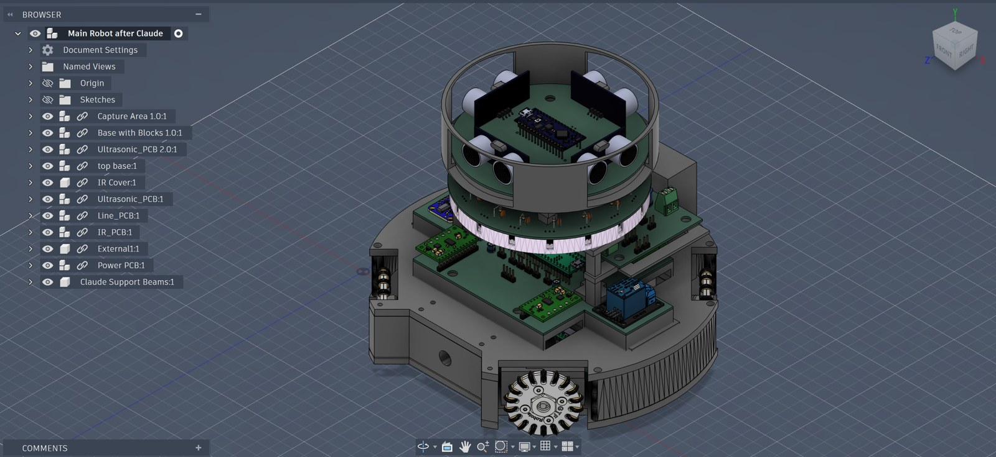
Q
FAQ · GENERAL
Which decisions were driven by which testing? What did you draw on?
Almost every decision is testing-driven (three below).
Motors overheating in stalls → external current limiter (~1 A cap).
IR losing the ball under ~60 cm → camera + IR fusion.
Ultrasonic board resetting under motor load → bulk caps per rail.
Inspiration: RCJ awesome-rcj-soccer TDPs/posters; then improved on them.
Both robots, ready to play
Evidence: Slide 8 graphs.
Notes:
Answers: Kushal (Darsh on wheels) Which decisions were driven by which testing? What did you draw on? - Almost every decision is testing-driven (three below). - Motors overheating in stalls → external current limiter (~1 A cap). - IR losing the ball under ~60 cm → camera + IR fusion. - Ultrasonic board resetting under motor load → bulk caps per rail. - Inspiration: RCJ awesome-rcj-soccer TDPs/posters; then improved on them.

Slide 13
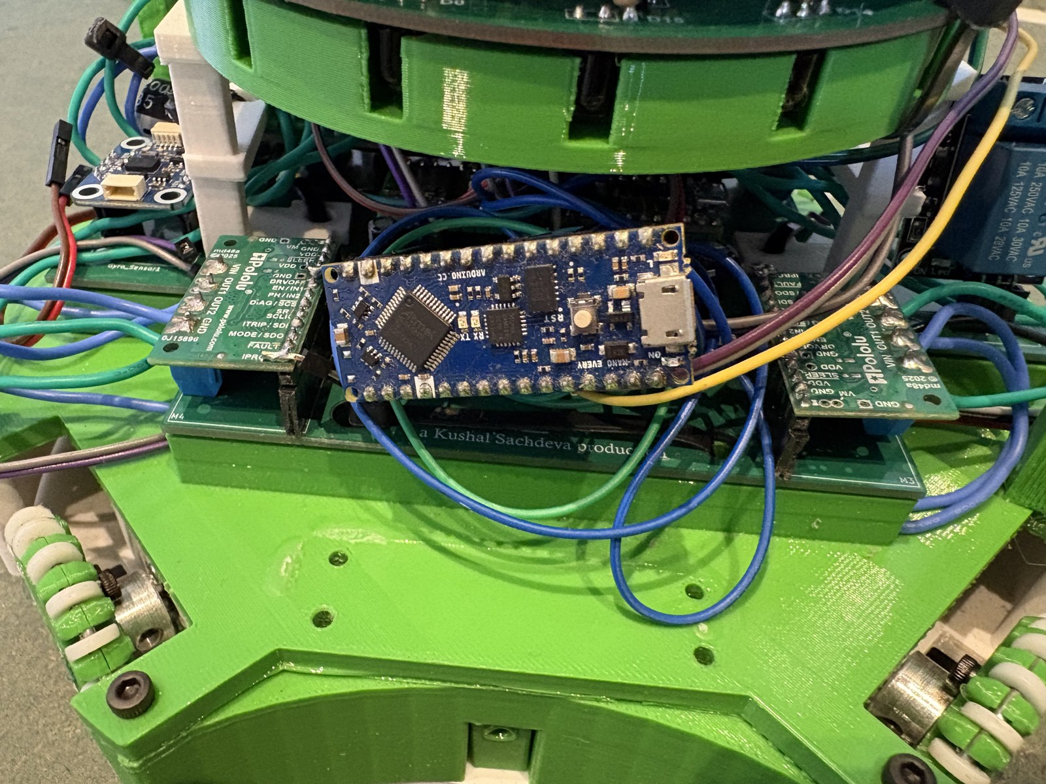
Q
FAQ · ELECTRICAL
Why did you pick this component? What did you blow up / how did you debug?
DRV8263H: 12 V power, 3.3 V logic, PH/EN, IPROPI current-sense — which enabled our stall protection.
Teensy 4.1: 600 MHz + many hardware UARTs (5 links + comms @100 Hz).
Blew up: drivers overheated when we grounded IPROPI for max current → Nano pulls DRVOFF above ~1 A (stall 1.6).
Ultrasonic PCB reset under load → scope showed rail sag → bulk caps per rail → stable.
External Arduino Nano current limiter
Evidence: 'Arduino Nano Current Controller' photo + stall-current graph.
Notes:
Answers: Kushal Why did you pick this component? What did you blow up / how did you debug? - DRV8263H: 12 V power, 3.3 V logic, PH/EN, IPROPI current-sense — which enabled our stall protection. - Teensy 4.1: 600 MHz + many hardware UARTs (5 links + comms @100 Hz). - Blew up: drivers overheated when we grounded IPROPI for max current → Nano pulls DRVOFF above ~1 A (stall 1.6). - Ultrasonic PCB reset under load → scope showed rail sag → bulk caps per rail → stable.

Slide 14
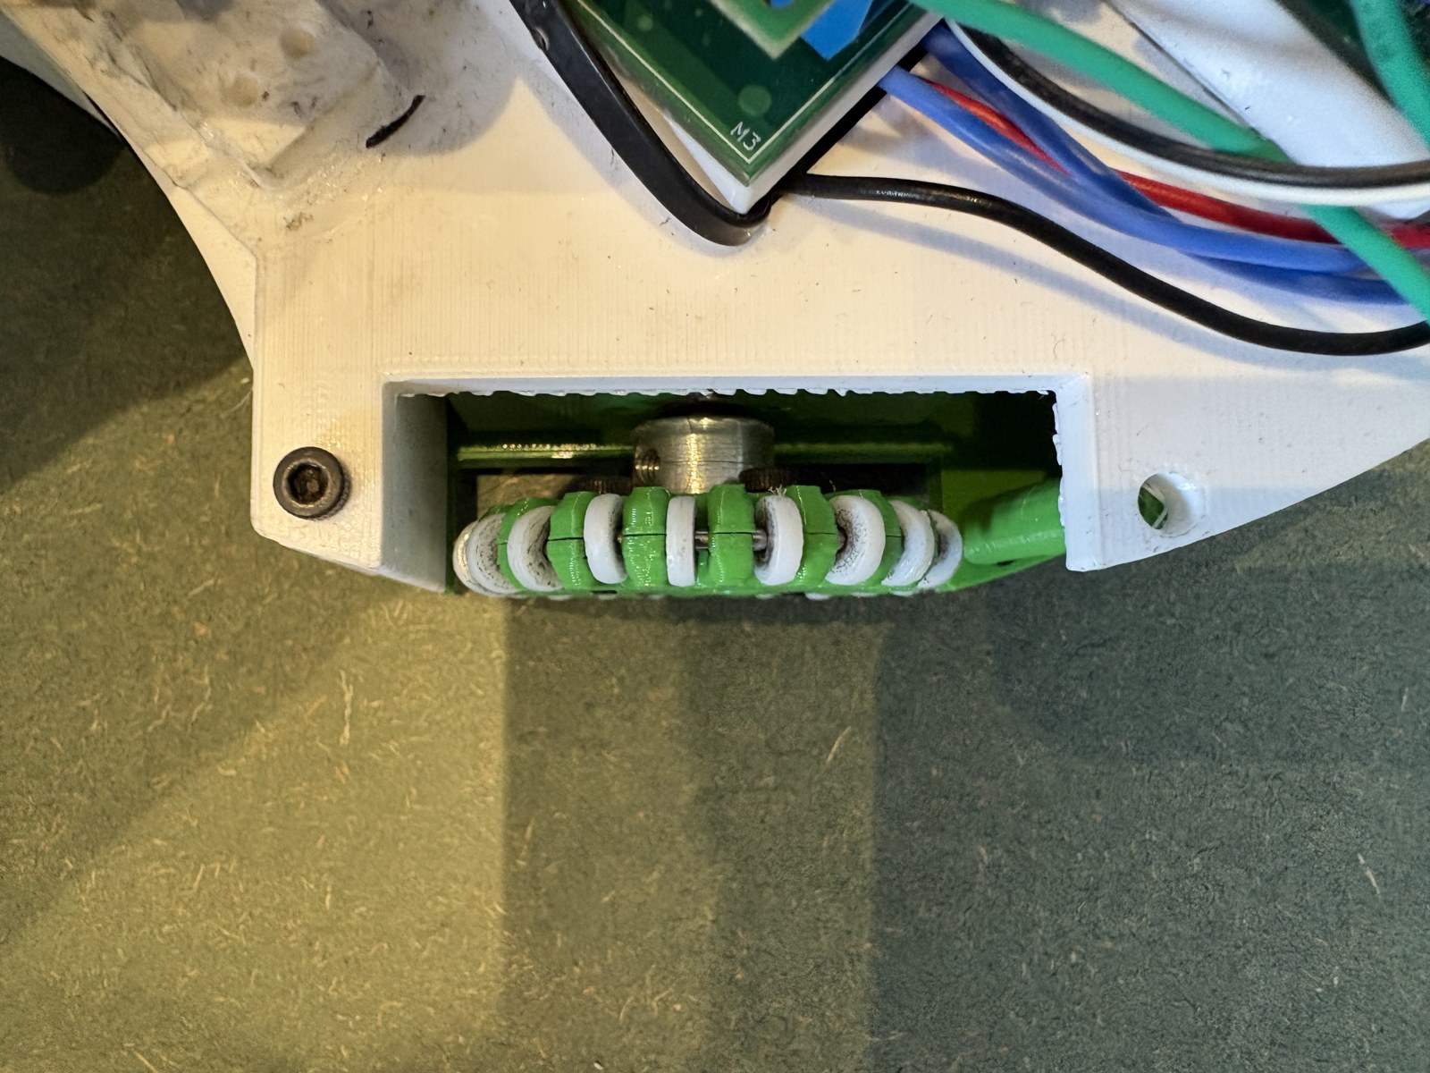
Q
FAQ · MECHANICAL
Kicker/dribbler/camera — why or why not? Materials? How did you make the wheels?
Kicker YES: 48 V solenoid scores decisively; defender reuses it to clear. Dribbler NO: printed mouth + solenoid already control the ball in the legal 1.5 cm zone.
Camera YES: goal aim + short-range ball reconfirmation.
Materials: PETG structure (stiff, impact-tough), TPU roller grip — after collision testing.
Wheels: fully printed — PETG hub, TPU rollers (15% infill), printed PETG axle; 3 print rounds.
Self-printed PETG + TPU omni wheel
Evidence: 'Wheel Opened Up' + 'Support Beams 3D Model'.
Notes:
Answers: Darsh Kicker/dribbler/camera — why or why not? Materials? How did you make the wheels? - Kicker YES: 48 V solenoid scores decisively; defender reuses it to clear. Dribbler NO: printed mouth + solenoid already control the ball in the legal 1.5 cm zone. - Camera YES: goal aim + short-range ball reconfirmation. - Materials: PETG structure (stiff, impact-tough), TPU roller grip — after collision testing. - Wheels: fully printed — PETG hub, TPU rollers (15% infill), printed PETG axle; 3 print rounds.

Slide 15
Q
FAQ · STRATEGY
Robots here, ball here — what do they do? Occluded goal / ball not in view?
Attacker sorts the bearing into a drive sector, translates straight at the ball (speed 250), gyro holds heading; on capture spins to the open corner (+/-5°) and kicks.
Defender stays on the line, lateral PID between ball and goal; only leaves to CLEAR on contact.
Occluded goal: no clean opening → corner-aim from the heading estimate, don't fire blindly.
Ball not in view (IR = 500): attacker sweeps/holds, stays legal via line + ultrasonics; defender re-homes to GUARD.
Attacker + defender roles
Evidence: Slide 7 field diagram.
Notes:
Answers: Darsh (Kushal on comms) Robots here, ball here — what do they do? Occluded goal / ball not in view? - Attacker sorts the bearing into a drive sector, translates straight at the ball (speed 250), gyro holds heading; on capture spins to the open corner (+/-5°) and kicks. - Defender stays on the line, lateral PID between ball and goal; only leaves to CLEAR on contact. - Occluded goal: no clean opening → corner-aim from the heading estimate, don't fire blindly. - Ball not in view (IR = 500): attacker sweeps/holds, stays legal via line + ultrasonics; defender re-homes to GUARD.

Slide 16
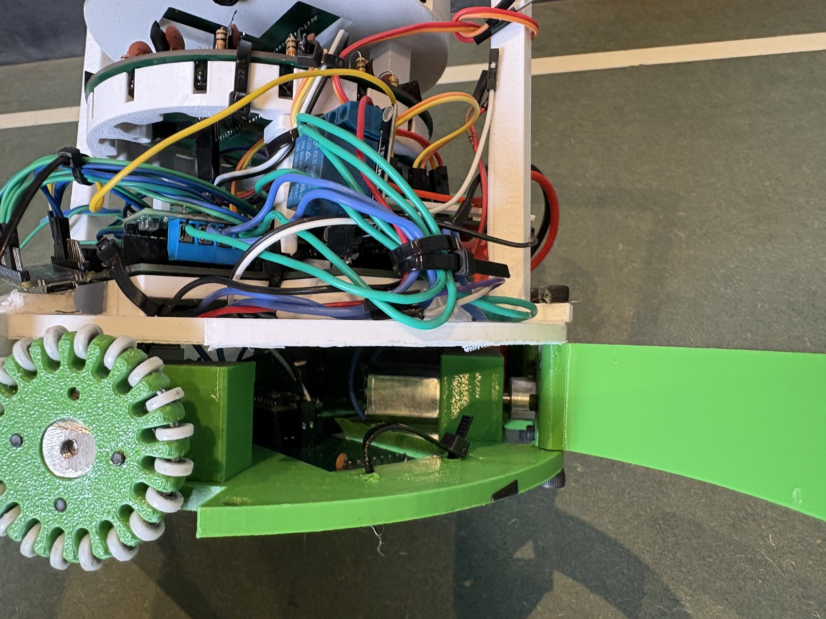
Q
FAQ · SOFTWARE
How does it make sense of sensors? How do you avoid out-of-bounds / getting stuck?
Each board pre-processes and sends a compact message: IR <dir>a<dist>b (500 = no ball); camera a framed packet; ultrasonic/line CRC-framed. Stale links (> 200 ms) ignored.
Main board fuses: IR+camera for the ball, line+ultrasonic for boundaries, IMU for heading.
Out of bounds: two-of-two rule — a side is the edge only when ultrasonic < 300 mm AND that side sees white, debounced 3 passes.
Defender back-wall rule: no reversing toward our own goal under 90 mm.
Debug door flap for live calibration
Evidence: Block diagram + IR vector-sum panel.
Notes:
Answers: Kushal How does it make sense of sensors? How do you avoid out-of-bounds / getting stuck? - Each board pre-processes and sends a compact message: IR <dir>a<dist>b (500 = no ball); camera a framed packet; ultrasonic/line CRC-framed. Stale links (> 200 ms) ignored. - Main board fuses: IR+camera for the ball, line+ultrasonic for boundaries, IMU for heading. - Out of bounds: two-of-two rule — a side is the edge only when ultrasonic < 300 mm AND that side sees white, debounced 3 passes. - Defender back-wall rule: no reversing toward our own goal under 90 mm.

Slide 17
Q
FAQ · DEVELOPMENT & DOCUMENTATION
What did you take ideas from? How did you track ideas and testing?
Sources: RCJ awesome-rcj-soccer archive; OpenMV docs; Pololu/TI datasheets.
Tracking: Notion board — every idea/task has an owner + deadline; results and 'what we tried' logged there.
Version control: code + issues on GitHub; files on Google Drive.
Testing ladder: components → single full robot → both robots together (role-switch + comms), with bench + field methods.
Published KiCad schematics
Evidence: GitHub repo + Notion screenshots + Slide 8.
Notes:
Answers: Kushal + Darsh What did you take ideas from? How did you track ideas and testing? - Sources: RCJ awesome-rcj-soccer archive; OpenMV docs; Pololu/TI datasheets. - Tracking: Notion board — every idea/task has an owner + deadline; results and 'what we tried' logged there. - Version control: code + issues on GitHub; files on Google Drive. - Testing ladder: components → single full robot → both robots together (role-switch + comms), with bench + field methods.

